Slide 1


Navigating the Modern Job Market
Melissa Roa
©coachingclosetoyou. All rights reserved 2025

Slide 2


Who am I?
Career strategist, NLP Practitioner and Coach
  +9 years of international experience.
  Specialist in NLP and strategy.
  My focus: Helping you recognize your value and overcome internal sabotage. With the right structure, I increase your self-awareness and confidence.
Melissa Roa

Slide 3

Introduction: The Modern Landscape
  Goal: Shift the mindset from passive searching to active navigation.
  Core Principle: Preparation reduces anxiety; structure builds confidence.
  Acknowledge: Your value is not defined by a job title; you have unique resilience and skills to offer.

Slide 4
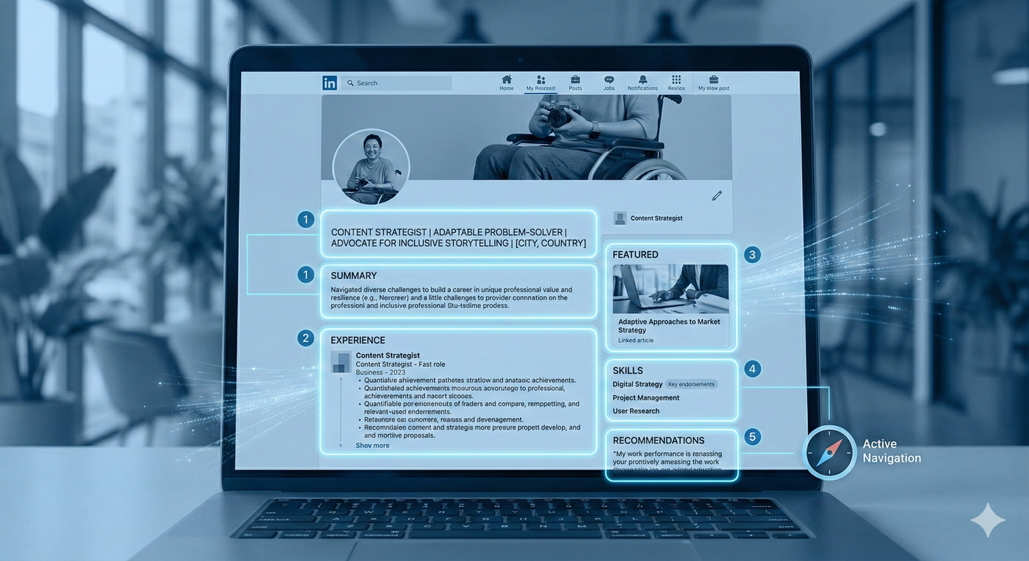
Beyond Job Boards
LinkedIn Strategy
  Optimize your profile to highlight "Strengths and Certifications".
  Research recruiters and hiring managers in the Irish market before reaching out.

Slide 5
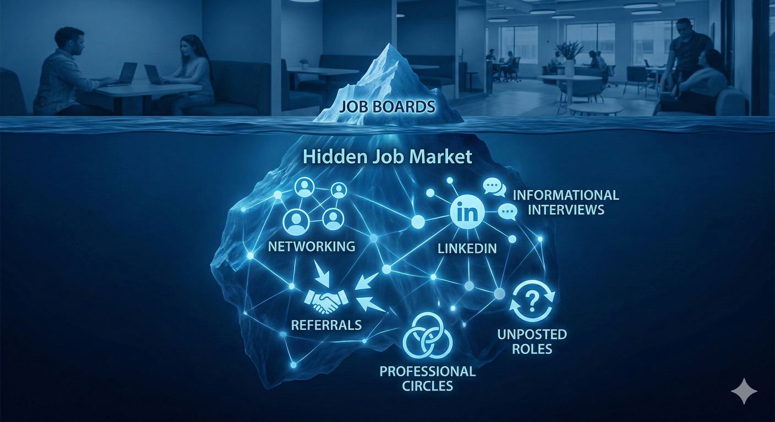
The Hidden Market
The Hidden Market:
  An estimated 70-80% of jobs aren't posted on traditional boards.
  Informational Interviews: Steps to reach out to professionals for advice, not just jobs.
  Networking: Building a professional circle through inclusive workshops and support.

Slide 6
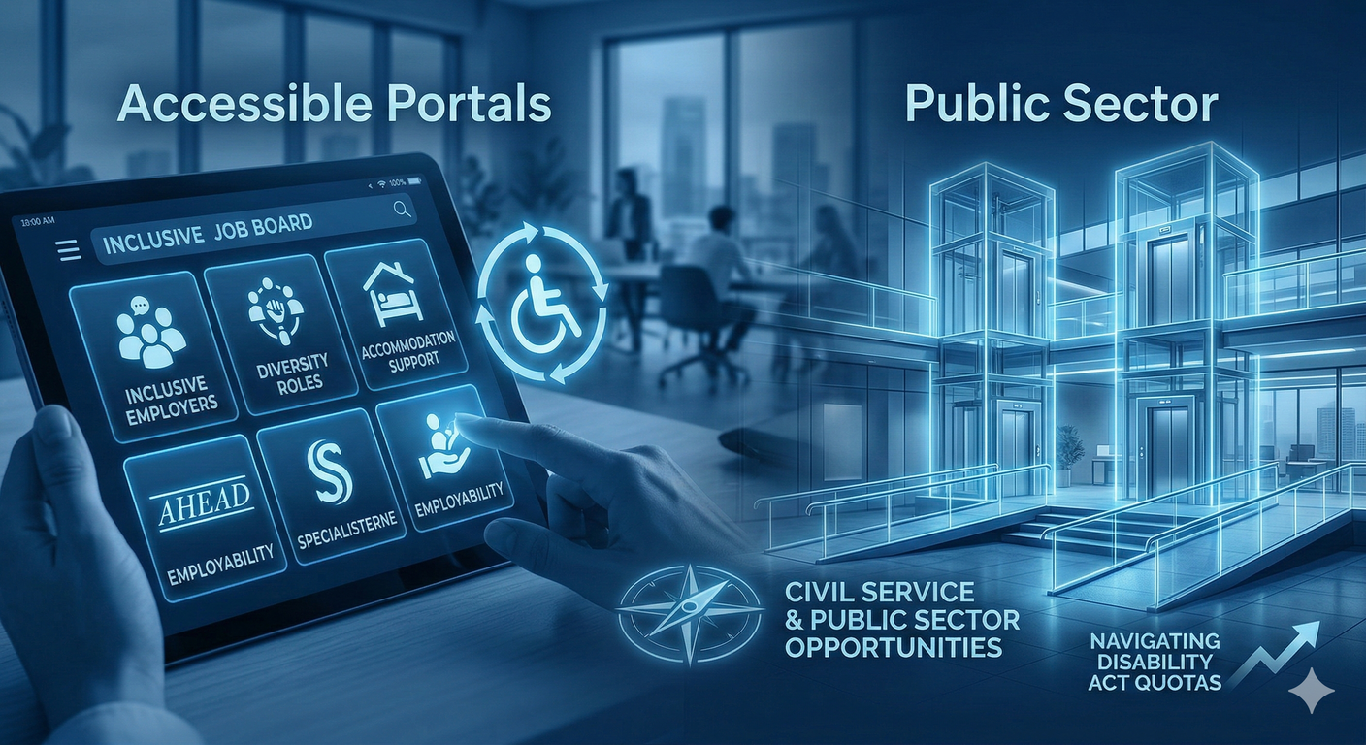
Accessible Portals and Public Sector
Specialized Support in Ireland:
  AHEAD.ie: Specific to graduates and job seekers with disabilities.
  EmployAbility Services: Offers 1:1 job coaching and placement.
  Open Doors Initiative: Provides inclusive employment supports, 1-1 career coaching, and inclusive webinar trainings.
  Vision Ireland (formerly NCBI): Their ETA team is currently very active. They provide workplace audits, assist with "Retention" if you
  are losing your sight while in a job,

Slide 7
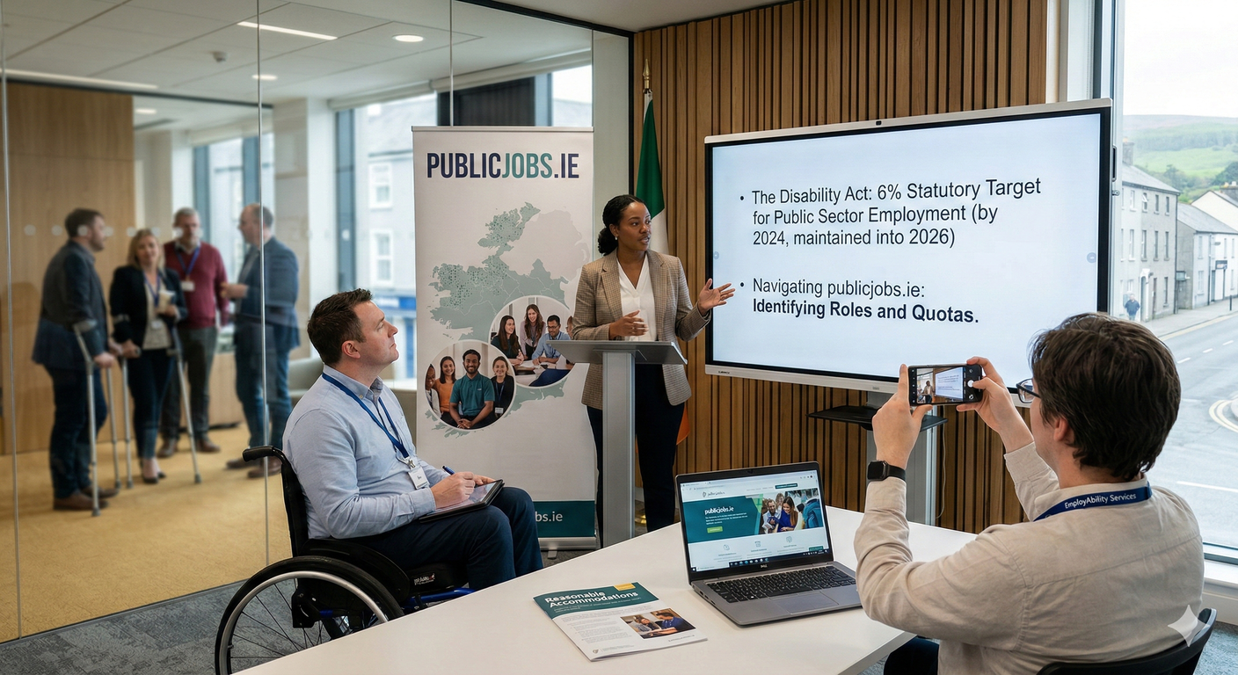
Public Jobs and Quotas
  The Disability Act: Discuss the statutory target for the employment of people with disabilities in the public sector.
  Navigating publicjobs.ie: How to identify roles within the Civil Service that utilize these quotas.

Slide 8
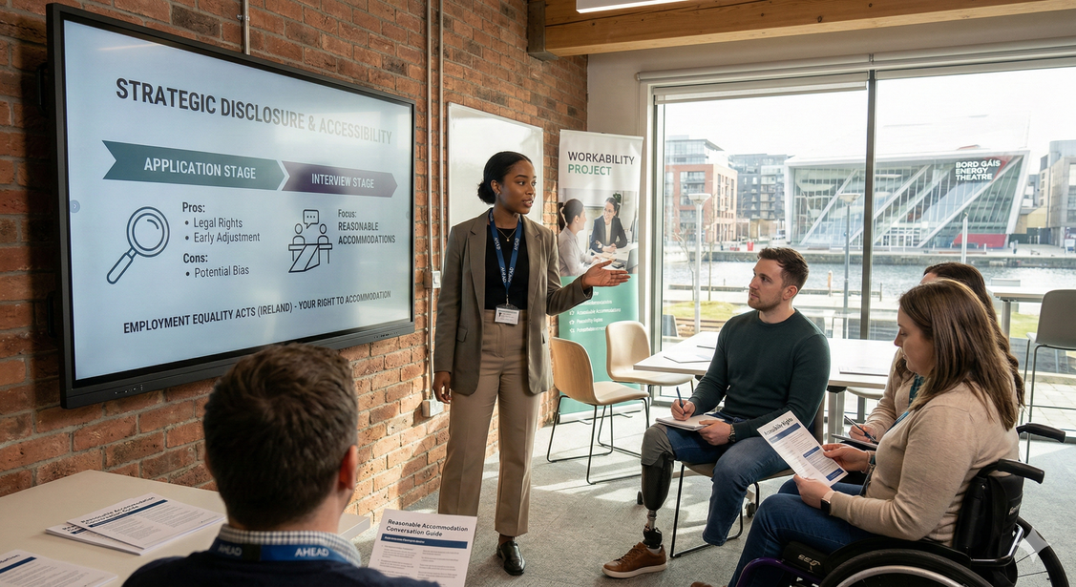
Strategic Disclosure and Accessibility
The "If, When, and How":
  Application Stage: Pros (clarity, legal protection)
  vs. Cons (potential unconscious bias).
  Interview Stage: Focus on "Reasonable Accommodations" under the Employment Equality Acts.
  The Conversation: Use the "Accommodation Conversation" to focus on what you need to do to perform at your best, rather than on limitations.
Key Law: Familiarize yourself with the
Employment Equality Acts in Ireland
regarding reasonable accommodations.

Slide 9
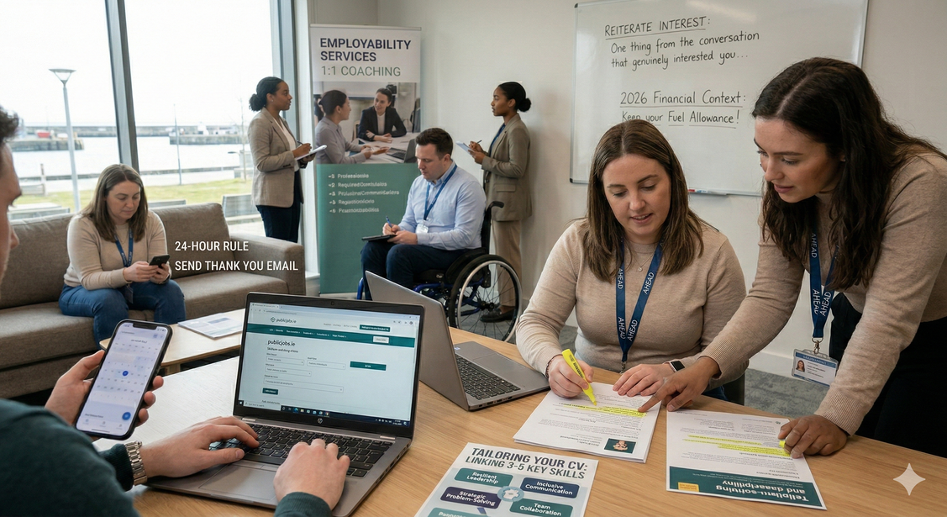
Personal Branding and The Art of Chasing
Tailoring Your CV:
  Link your 3-5 key skills directly to the
  job description.
  Showcase your resilience as a
  professional strength.
Strategic Follow-Up:
  The 24-Hour Rule: Send a "Thank You" email within 24 hours of an interview or meeting.
  Reiterate Interest: Briefly mention one thing from the conversation that genuinely interested you to stay on their radar.

Slide 10
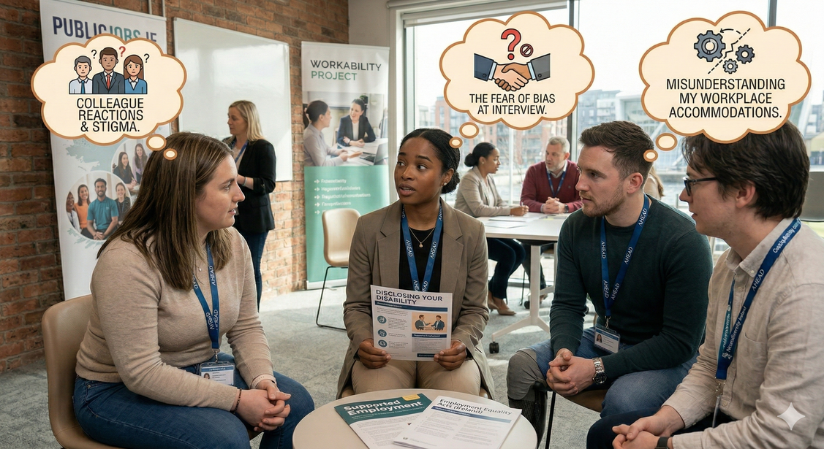
Q&A and Discussion
Let’s share:
  What is one aspect of disclosing your disability that you feel most anxious about?
Support Resources Recap:
  Intreo: For income supports and job-seeking help.
  National Learning Network (NLN):
  For skill-building and recovery programs.
  Citizens' Information: For legal
  entitlements and support.

Slide 11
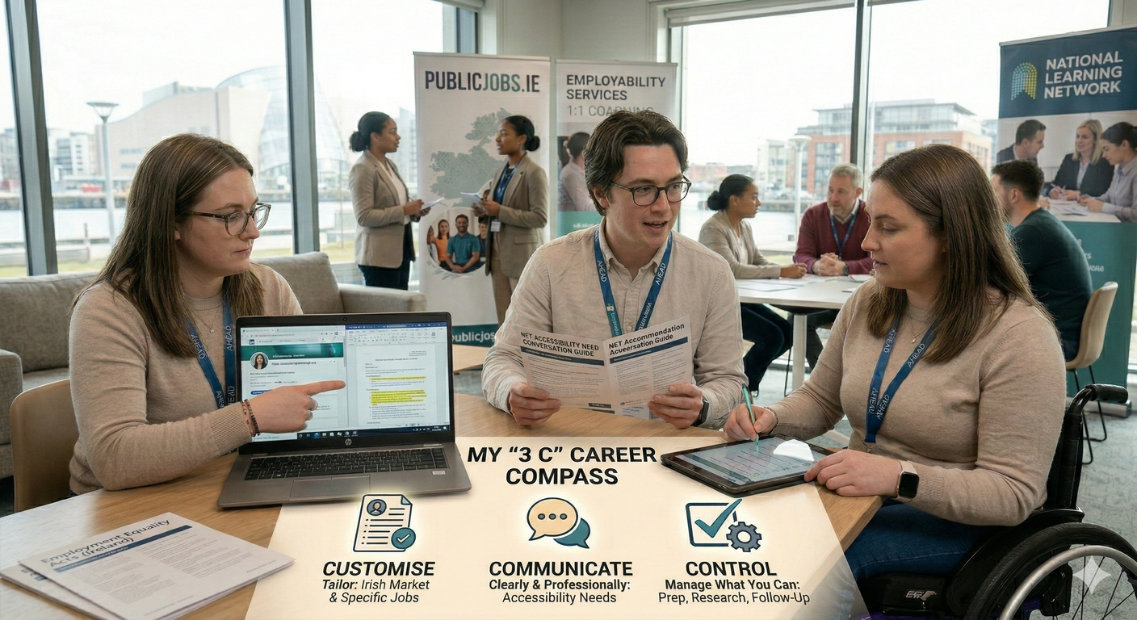
Workshop Key Takeaways (The 3 Cs)
  Customise: Your CV and LinkedIn profile to the Irish market and specific job descriptions.
  Communicate: Clearly and professionally convey your accessibility needs when the time is right.
  Control: Manage what you can, your preparation, your research, and your follow-up, to reduce stress.
  "You are not alone on this path; your journey is valid and supported."

Slide 12
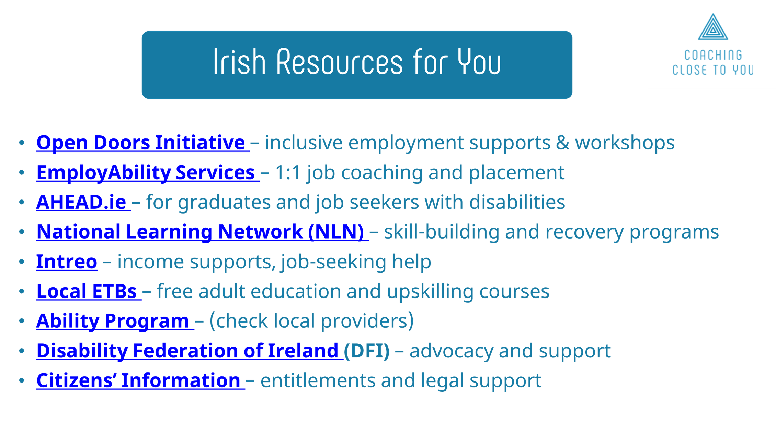

Slide 13
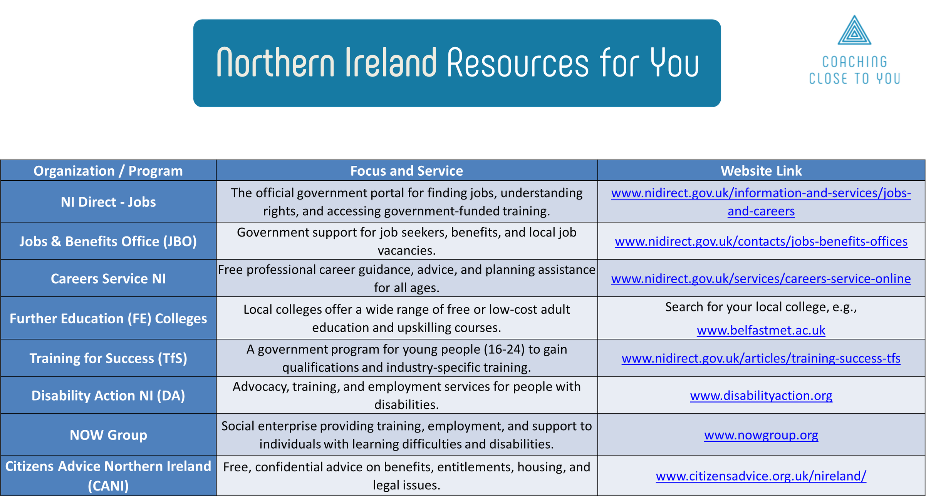

Slide 14

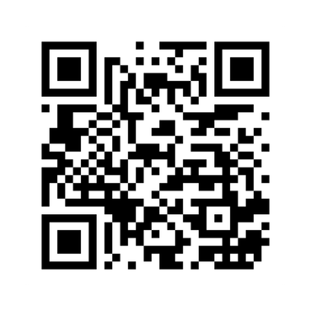
Get in touch with us!
Thank You!
Email: melissa@coachingclosetoyou.com
WhatsApp: +353 83 093 9484
LinkedIn: /in/melroa
Web: coachingclosetoyou.com

