Slide 1
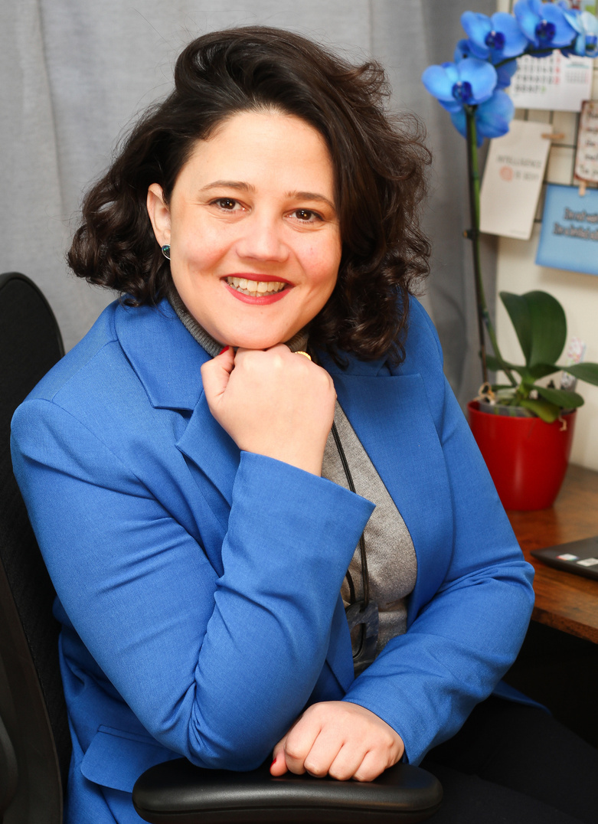

Interview Preparation Tips for Beginners
Melissa Roa
©coachingclosetoyou. All rights reserved 2025
Notes:
1.7.2013
‹#›

Slide 2


Who am I
I’m a Career Coach and Certified Life & Business Coach with over 9 years of experience. I use NLP techniques to boost self-awareness and help professionals align their careers with purpose. My focus is on career strategy and growth, empowering people to move forward with clarity, confidence, structure, and intention.
Notes:
1.7.2013
‹#›

Slide 3
Today you'll learn 3 Types of "Interviews"
    1. Traditional: In-person or Live Video (formal setting).
    2. Virtual: Pre-recorded/One-way video or phone calls.
    3. The Application/CV Drop: The crucial first "screening" interview that happens before you even speak to a person.
    Core Principle: "Preparation reduces anxiety. Our goal is to make you feel confident and in control."
Notes:
1.7.2013
‹#›

Slide 4
The Pre-Interview Preparation (The Foundation)
🔍 Research is Your Superpower
    The Company: What do they do? Check their "About Us" page, mission, and recent news.
    Tip: Find one thing they do that genuinely interests you to mention.
    The Job: Print the job description. Highlight 3-5 key skills they are looking for. Your answers must link back to these!
    The Interviewers (if known): Check LinkedIn, what are their roles?
    This helps you understand their perspective.
Notes:
1.7.2013
‹#›

Slide 5
🦼 Accessibility & Disclosure (The Irish Context)
Know Your Rights
    If you need it, you can just mention the Employment Equality Acts in Ireland. Employers must provide "reasonable accommodations."
The Accommodation Conversation:
    When do you ask: The best time is after you get the interview invite.
    How to Ask: Keep it professional and simple (You will get a template message)
    Crucial Point: Focus on the accommodation you need to do the job well, not a diagnosis.
Notes:
1.7.2013
‹#›

Slide 6
Tips for Different Interview Formats
🧑‍🤝‍🧑 In-Person Interview Tips
  Logistics Check: Practice the route, check traffic, and familiarize yourself with the building entrance. Arrive 10-15 minutes early.
  Dress Code: Smart, clean, and comfortable. If you're unsure, "business casual" is usually safe.
  The Essentials: Bring a folder with: extra CV copies, a notepad and pen (for taking notes!), and your pre-prepared questions.
  Body Language: Maintain eye contact (or focus on the interviewer's forehead), a firm handshake, and listen intently before answering.
Notes:
1.7.2013
‹#›

Slide 7
Tips for Different Interview Formats
💻 Online/Video Interview Tips
  Tech Check: Test your microphone, camera, and internet connection 30 minutes before.
  The Setting: A neutral background (or a professional virtual background), good lighting
  Minimize Distractions: Mute your phone, close unnecessary browser tabs, and warn household members.
  The Eye Trick: Look at the camera lens when speaking,
  not the screen.
Notes:
1.7.2013
‹#›

Slide 8
Tips for Different Interview Formats
📄 The Application / CV Drop-Off (The Initial Screening)
  Why it's an interview: "Your CV and cover letter are being interviewed first!"
  Customise Everything: NEVER use a generic CV/Cover Letter. Tweak it to include keywords from the job description.
  Attention to Detail: Check for spelling and grammar errors three times. A clean CV shows attention to detail.
  Online Forms: Treat every box like a key question. Be clear, concise, and professional. Save your answers in a document in case the form crashes!
Notes:
1.7.2013
‹#›

Slide 9
Tips for Different Interview Formats
📄The Spontaneous Interview: Mastering the CV Drop-off
  When you drop off a CV in person, assume the person who receives it might be the hiring manager, and the interview starts now.
  A. Timing is Everything (Especially for Energy Management)
  Optimal Timing: The best time for walk-ins is typically 9:30 AM to 11:00 AM or 2:00 PM to 4:00 PM.
  Avoid: Immediately upon opening, during the lunch rush (12 PM - 1:30 PM), or near closing.
Notes:
1.7.2013
‹#›

Slide 10
Tips for Different Interview Formats
📄The Spontaneous Interview: Mastering the CV Drop-off
  Manage Your Reserves: If you have a condition that affects your energy levels (e.g., fatigue, pain), choose a time of day when you are reliably at your sharpest. Do not schedule a drop-off at the end of a long day if your energy dips.
  Pre-Drop Ritual: Take 5 minutes in your car or at a nearby coffee shop before entering. Check your phone is off, check your appearance, and review your elevator pitch and the 3 things you love about the company. This is your mental preparation time.
Notes:
1.7.2013
‹#›

Slide 11
The Core Content (What to Say)
  The Hardest Question: "Tell me about yourself."
  Formula: Past (Relevant Experience) Present (Your Current Role)
Future (Why This Role). Keep it to 90 seconds.
Notes:
1.7.2013
‹#›

Slide 12
Introducing the STAR Method
The simplest way to answer behavioral questions
("Tell me about a time you...")
  S - Situation: Set the scene.
  T - Task: Describe your goal.
  A - Action: What you did (use "I," not "we").
  R - Result: What was the outcome? Use numbers/facts if possible.
Practice: Use the STAR method to prepare 2-3 examples of
common skills, such as problem-solving or teamwork.
Notes:
1.7.2013
‹#›

Slide 13
Answering Common Questions
  Why do you want to work here? (Connect your values/goals to their mission.)
  Why are you leaving your current job? (Focus on the positive move forward, not the negative past.)
  Your greatest strength/weakness? (Strength: Relevant to the job. Weakness: A real, but minor fault you are actively working to improve.)
Notes:
1.7.2013
‹#›

Slide 14
Asking THEM Questions (Your Turn)
  Always ask 2-3 prepared questions. This shows interest.
  Good Examples:
  "How is success measured in this role?"
  "What's the team culture like?"
  What can I expect from a workday as XX in the XX company?
Notes:
1.7.2013
‹#›

Slide 15
Key Takeaways (The 3 Cs)
  Customise: Your CV and answers to the job description.
  Communicate: Your accessibility needs clearly and professionally.
  Control: What you can (prep, logistics, tech) to reduce stress.
Post-Interview: Send a quick Thank You email within 24 hours.
Reiterate your interest and thank them for their time.
Notes:
1.7.2013
‹#›

Slide 16
Q&A / Discussion
Do you have any questions?
What is one interview-related question that you are feeling most anxious about right now?
Thank you for showing up. That’s a win in itself!
You are not alone on this path
Your journey is valid and supported
Notes:
1.7.2013
‹#›

Slide 17

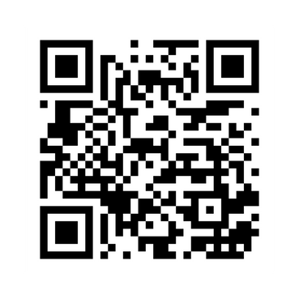
Get in touch with us!
Thank You
www.coachingclosetoyou.com
@coachingclosetoyou.en
melissa@coachingclosetoyou.com
Notes:
1.7.2013
‹#›

