Slide 1
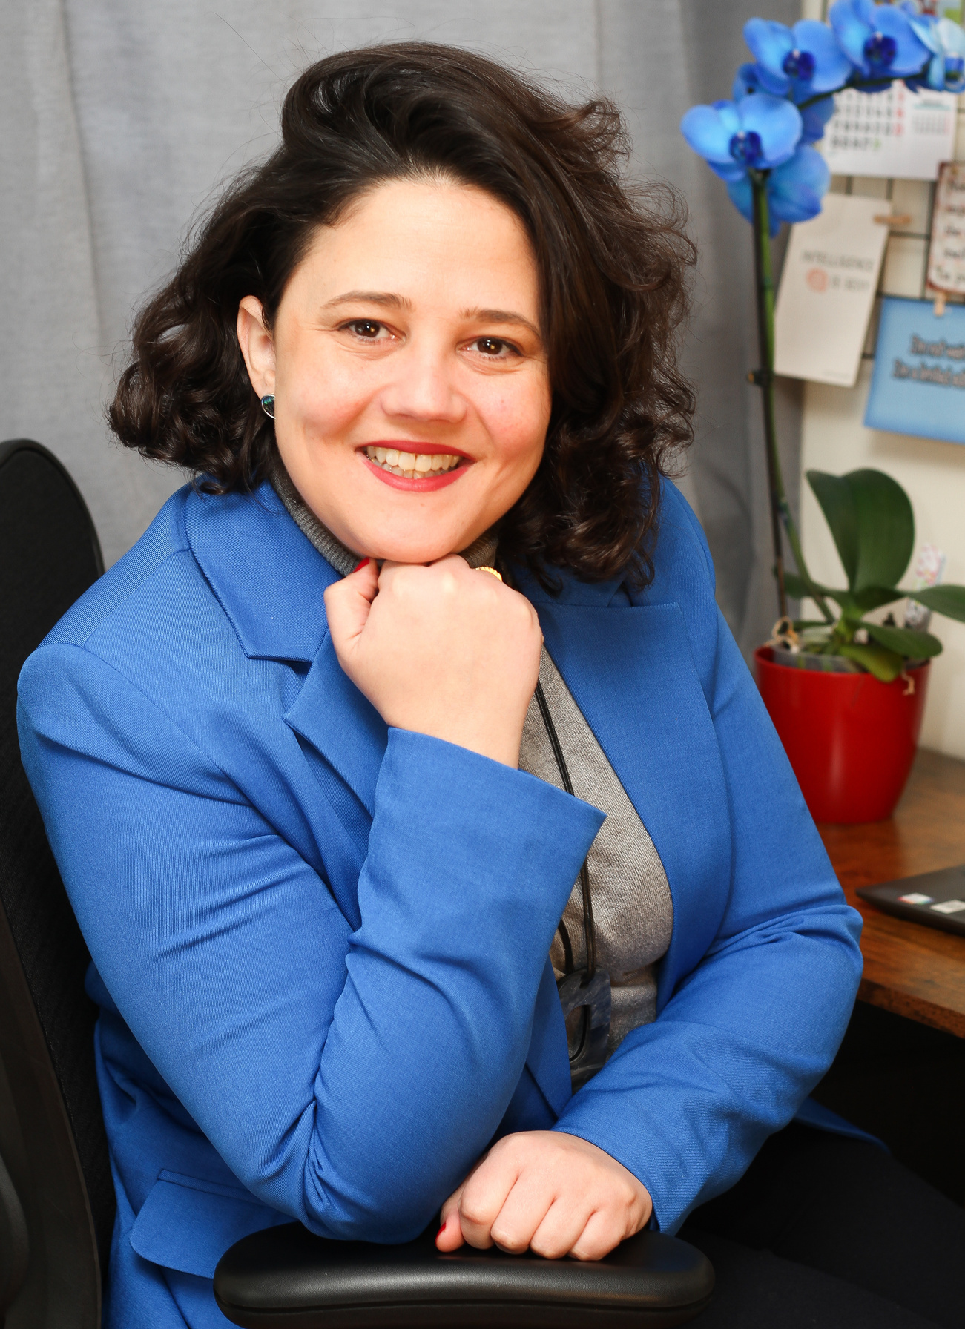

Finding Direction
Clarifying Your Next Steps
Setting a structure to help you reflect, refocus, and move forward
Melissa Roa
©coachingclosetoyou. All rights reserved 2025

Slide 2


Who am I
I’m a Career Coach and Certified Life & Business Coach with over 9 years of experience. I use NLP techniques to boost self-awareness and help professionals align their careers with purpose. My focus is on career strategy and growth, empowering people to move forward with clarity, confidence, structure, and intention.

Slide 3
Today you'll learn
Understand where you are now
Explore what’s next
Learn how to take action
How to set your goals
Access supports and resources

Slide 4
Acknowledging Where You Are
Losing a job is a significant life change, and it is ok if you feel lost at first
It’s okay to feel uncertain, overwhelmed, or stuck
However, remember that you're not starting from scratch. You’re starting from experience.
Experience, preparation, and structure can be determinants in securing a new job.

Slide 5
Why Direction Matters
Clarity builds confidence
It’s easier to take action when you know your focus
Direction gives you structure and motivation
Your “next step” is not a life decision — it’s a starting point
When you know what you want, others can help you get there
“You don’t need to have it all figured out. You just need your next move.”

Slide 6
What Matters to You?
Work on your self-awareness
Ask yourself:
What are your skills and passions?
What are my strengths and talents?
What type of work environment suits you?
What supports do you need (e.g., flexibility, assistive tech)?
What are my non-negotiables (e.g., location, flexibility, support needs)?

Slide 7
Where Are You Now?
Assess your current situation:
What do you already have? (Experience, time, support, benefits)
Do you have clarity on the role you would like to focus?
What are your current barriers and possible solutions?
Are you connected to any services yet?
Is your CV and LinkedIn ready?

Slide 8
Choosing a Direction
What’s your next step?
Start with the following:
Define the area and role you will focus on
Update your CV and LinkedIn considering your focus area (Remember, about the skills keyword optimization)
Seek Career events, workshops, and networking opportunities
Ensure you search for jobs to apply to on different platforms every day
Reach out to a support organisation
Explore a short (free) online course in your focus area
“Progress is progress, no matter how small.”

Slide 9
Informing & Expanding Your Network
People want to help – Let them know how
Tell people what you’re looking for
Use a simple sentence:
“I’m exploring work in (area) because I enjoy (reason). If you hear of something, let me know.”
Who to talk to:
Friends, family, neighbours
Former colleagues or employers
Disability employment support services
Social media or LinkedIn
Open Doors Network events and webinars

Slide 10
Making It Manageable
Break your goal down into small steps:
Try weekly goals, like:
“Research at least 1 new job area I’m curious about.”
“Talk to 1 person about my career goals”
“Ask for support to update my CV.”
Track your progress with a simple system
| What I Did | What Worked | What I’ll Try Next |

Slide 11
Confidence & Self-Belief
Your value is not defined by a job title
You have something to offer: skills, personality, and resilience (ensure it is well showcased in your CV, LinkedIn, Cover Letter, and during interviews)
Take breaks. Be kind to yourself
Focus on effort, not perfection
Confidence grows through action

Slide 12
Irish Resources for You
You’re Not Alone, support is available.
Open Doors Initiative – inclusive employment supports & workshops
EmployAbility Services – 1:1 job coaching and placement
AHEAD.ie – for graduates and job seekers with disabilities
National Learning Network (NLN) – skill-building and recovery programmes
Intreo – income supports, job-seeking help
Local ETBs – free adult education and upskilling courses
Ability Programme – (check local providers)
Disability Federation of Ireland (DFI) – advocacy and support
Citizens’ Information – entitlements and legal support

Slide 13
Final Words & Staying Connected
You’ve already taken the first step today!
Do you have any questions? It is your time!
Thank you for showing up, that’s a win in itself
You are not alone on this path
Your journey is valid and supported

Slide 14

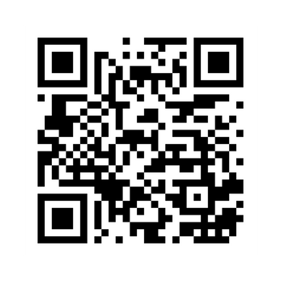
Get in touch with us!
Thank You
www.coachingclosetoyou.com
@coachingclosetoyou.en
melissa@coachingclosetoyou.com

