Slide 1


Entrepreneurship for Beginners
Demystifying the process and building
your own path.

Slide 2

Today’s Journey
  The "What": Choosing the right business style
  The "How": A 7-Step Ireland Setup Guide
  The "Map": Your first Business Plan
  The Toolkit: Checklist & Jargon Buster (Extras - Takeaway)

Slide 3
Defining Your Journey
Lifestyle vs Needs
Lifestyle Alignment:
  Consider how much time you can realistically commit.
  Does this venture support your ideal day-to-day life, or does it demand 80-hour weeks?
  Your path should serve your life, not consume it.
Functional Needs:
  Analyze your financial requirements and existing commitments.
  Are you looking for a supplementary income (side-hustle) or a primary living? Your "Needs" define the risk level you can afford.
Key Takeaway
Align your venture type with your personal boundaries and lifestyle constraints before you register.

Slide 4

Sole Trade & Small Business Entrepreneurship
Overview: This form of entrepreneurship usually starts with personal savings or support from family and friends. It is commonly managed by one person or a small group.
Pros
  High potential for rapid growth and large profits.
  Can attract investors, including venture capitalists and angel investors.
  Opportunity to disrupt industries and introduce new solutions.
Cons
  High risk of failure, especially in the early stages.
  Requires substantial funding and constant investor confidence.
  Founders often face intense pressure and long working hours.
Advice: If scaling is the goal, focus on building investor confidence, protecting your mental health, and building a resilient core team from day one.

Slide 5
Social, Corporate and Side Paths
Social Entrepreneurship
  Using business methods to solve social or environmental problems while aiming for financial sustainability.
  Pros & Cons: High purpose and deep community support, but introduces a complex "double-bottom line" (balancing Impact + Profit).
  Advice: To thrive, you must treat financial sustainability as strictly as your mission. You cannot create impact if the business cannot pay its bills.
Intrapreneurship
  Employees developing innovative ideas, products, or systems within an existing organization. The organization provides resources, while the employee contributes entrepreneurial thinking.
  Pros and Cons: Complete safety net of a salary and corporate resources, but you deal with limited control and bureaucratic hurdles.
  Advice: Use the company's existing scale to prototype rapidly without personal financial risk.
The Side Hustle
  Note: A side hustle can be considered an intrapreneurial venture if you have a job and also run a business.
  If an individual is studying, the business operates more like a sole trader because it eventually becomes their main source of independent income. Use this as a risk-free testing ground.

Slide 6
Step 1 - The Safety Net (DSP/Intreo)
Crucial Tip: Talk to Intreo before you register anything.
  Back to Work Enterprise Allowance (BTWEA): Allows you to keep a portion of your social welfare payment while starting a business.
  Short-Term Enterprise Allowance (STEA): For those on Jobseeker’s Benefit.
  Why? It provides financial breathing room while you build your momentum.

Slide 7

Step 2 – Choosing Your Legal Structure
Sole Trader:
  Pros: Easy to set up, less paperwork.
  Cons: You are personally responsible for business debts.
Limited Company (LTD):
  Pros: The business is a separate "legal person." Your personal assets are protected.
  Cons: More expensive to set up and requires annual audited accounts.

Slide 8

Step 3 – Naming & The CRO
  Registering a Business Name: If you don't use your own name (e.g., "John Doe Consulting"), you must register a "Trading As" name with the Companies Registration Office (CRO).
  Fee: Usually €20 online.
  Executive Function Tip: Use the search bar on cro.ie first to see if your name is already taken!

Slide 9

Step 4 – Revenue & Tax
Tax Registration Forms
  Form TR1: Used by Sole Traders and Partnerships to register for Income Tax and VAT.
  Form TR2: Used by Limited Companies to register for Corporation Tax and VAT.
Value Added Tax (VAT)
A consumption tax is added to products and services at every stage of production, from raw materials to the final sale. While businesses collect it, the final cost is paid by the consumer.
It is widely used globally (especially in the EU)
as a percentage of the price.
VAT Thresholds (2026)
  Goods: Over €85,000 / year.
  Services: Over €42,500 / year.
Why does this matter?
Registering correctly ensures you aren't hit with back-dated tax or penalties. Saving 25% of all earnings in a separate "Tax Folder" from day one provides the financial peace of mind needed to grow.

Slide 10

Step 5 Banking and Step 6 Insurance
  Banking: Keep it separate! Even as a Sole Trader, use a different bank account for business. It makes tax time 10x easier.
  Insurance: Public Liability: If a customer gets hurt.
  Professional Indemnity: If you give advice that causes a client to lose money.

Slide 11

Step 7 – Market Research
  The "Market Gap": What is missing in your community?
  Testing: Don’t spend thousands yet. Talk to 10 potential customers.
  Accessibility Check: Is your product/service easy for everyone to use?

Slide 12
The Business Plan
Your Business Plan is a "Living Map"
  It’s not a static document: It’s a tool to help you think.
  What goes in it?
  What do you sell?
  Who buys it?
  How do they find you? (Marketing)
  How do you make money? (Finance)
Executive Function Tip: Start with a "One Page Plan" using bullet points. No long essays required!

Slide 13
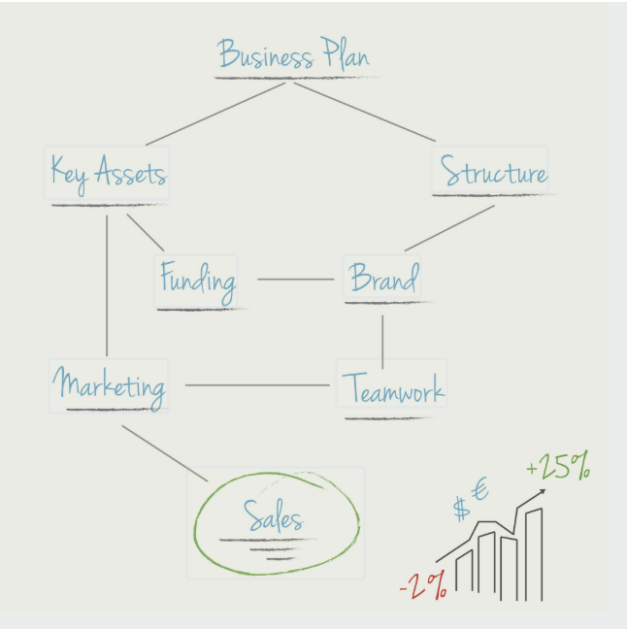
The Business Plan
Your Business Plan is a "Living Map"
  It’s not a static document: It’s a tool to help you think.
  What goes in it?
  What do you sell?
  Who buys it?
  How do they find you? (Marketing)
  How do you make money? (Finance)
Executive Function Tip: Start with a "One Page Plan" using bullet points. No long essays required!

Slide 14
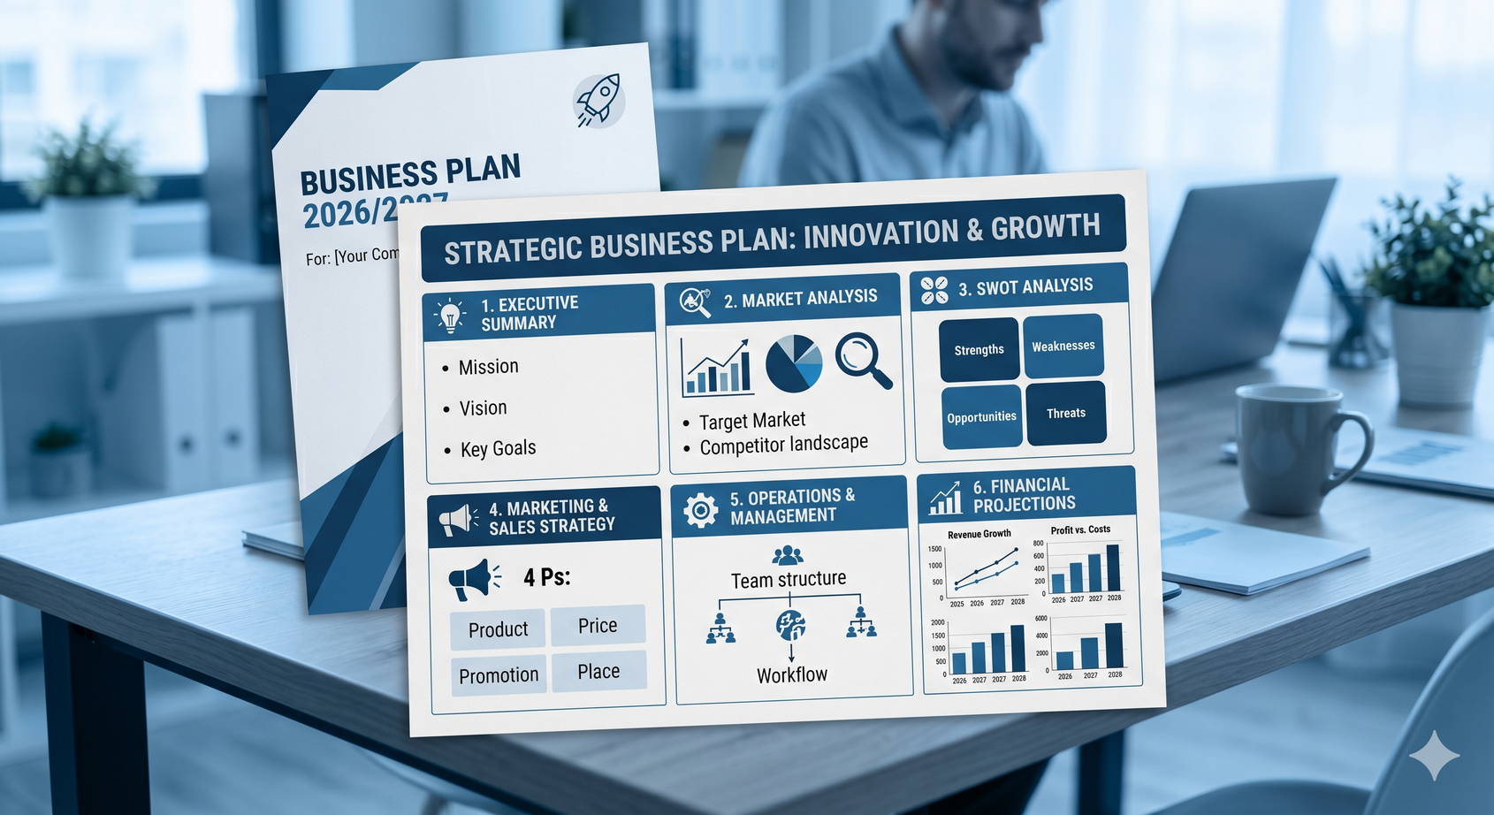
The Business Plan
  Executive Summary: A 1-page snapshot of your business idea, problem solved, and core mission (write this last).
  Company Description: Your business name, what you do, and your chosen legal structure (e.g., Sole Trader vs. Limited Company).
  Market Analysis: Your target customers, current industry trends, and a quick look at your main competitors.
  Marketing & Sales Strategy: How you plan to price your product/service, and where you will promote it to attract customers.
  Operations & Management: The logistics of how your business runs daily, your team setup, and the tools you need.
  Financial Projections: Your estimated startup costs, a basic cash-flow forecast, and your expected timeline to become profitable.

Slide 15

Extra Resources
You will receive it by email
Your Take-Away Toolkit
  The Step-by-Step Checklist: A "Ready-to-Print" list you can tick off as you go.
  The Jargon Buster: Translating "Revenue-speak" into Plain English.
  Local Enterprise Office (LEO): Your best friend for grants and training.

Slide 16



One to One
Coaching Sessions
Watch out for the registration link in the newsletter and when you receive this presentation
Free and available to you!
You are not alone!
Avail of this extra support, where you run the agenda of the sessions!

Slide 17
It is your turn now
Any questions?
Now, take a moment to think about your business idea.
After all this information, how do you feel about entrepreneurship?

Slide 18

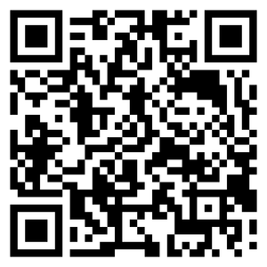
The awakening of
FUTURE
Stop acting in someone else's script. Be the director of your own life. Design the vision, choose who enters the scene, and execute each chapter with the truth of someone who already knows that the ending is a masterpiece.
Melissa Roa

